Slide 1
Knowledge Graphs G. Falquet
Source:
Hogan, A., Blomqvist, E., Cochez, M., d’Amato, C., de Melo, G., Gutierrez, C., Gayo, J. E. L., Kirrane, S., Neumaier, S., Polleres, A., Navigli, R., Ngomo, A.-C. N., Rashid, S. M., Rula, A., Schmelzeisen, L., Sequeda, J., Staab, S., & Zimmermann, A. (2022). Knowledge Graphs. ACM Computing Surveys, 54(4), 1–37. https://doi.org/10.1145/3447772

Slide 2
Contents
Hogan, A. et al. (2022). Knowledge Graphs. ACM Computing Surveys, 54(4), 1–37. https://doi.org/10.1145/3447772
Definitions
Data models and query languages
Representations of schema, identity, and context
Quality dimensions by which a knowledge graph can be assessed
Deduction in KG
Induction in KG
Graph analytics
Graph embeddings
Graph neural networks
Symbolic learning: rule and axiom mining

Slide 3
Definitions
A knowledge graph as a graph of data intended to accumulate and convey knowledge of the real world, whose nodes represent entities of interest and whose edges represent relations between these entities.
Knowledge may be composed of simple statements,
“Santiago is the capital of Chile”,
or quantified statements
“all capitals are cities”.
Simple statements can be accumulated as edges in the data graph.
Quantified statements require a more expressive way to represent knowledge – such as ontologies or rules

Slide 4
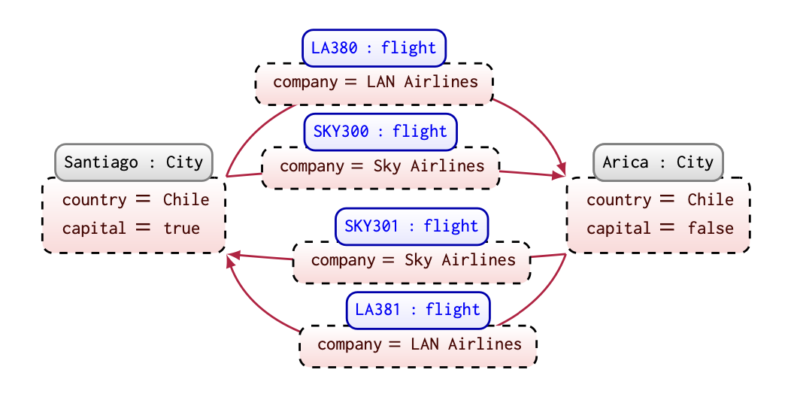
Data models and query languages
Directed edge-labelled graphs
e.g. RDF
Graph datasets
e..g RDF datasets
Property graphs
property-value pairs
on nodes
on edges
typed nodes and edges
Translation without loss of information DELG ↔︎ PG
Hogan et al. (2022)

Slide 5
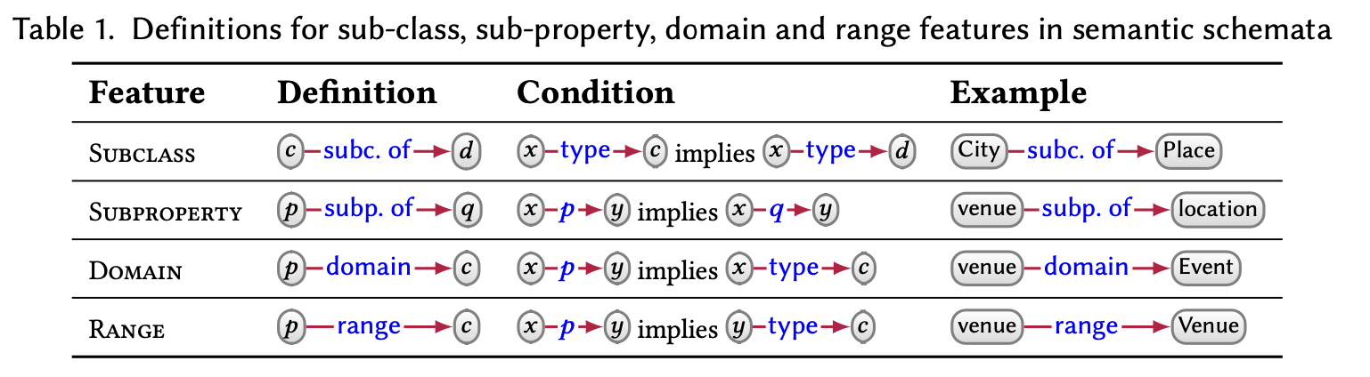
Schema
Semantic schema
e.g. RDF Schema
Hogan et al. (2022)

Slide 6
Schema
Validating schema
to represent diverse, incomplete data at large-scale → OWA
in some scenarios → guarantee that (part of) the data graph is “complete”.
UML class diagram
SHACL shapes

Slide 7
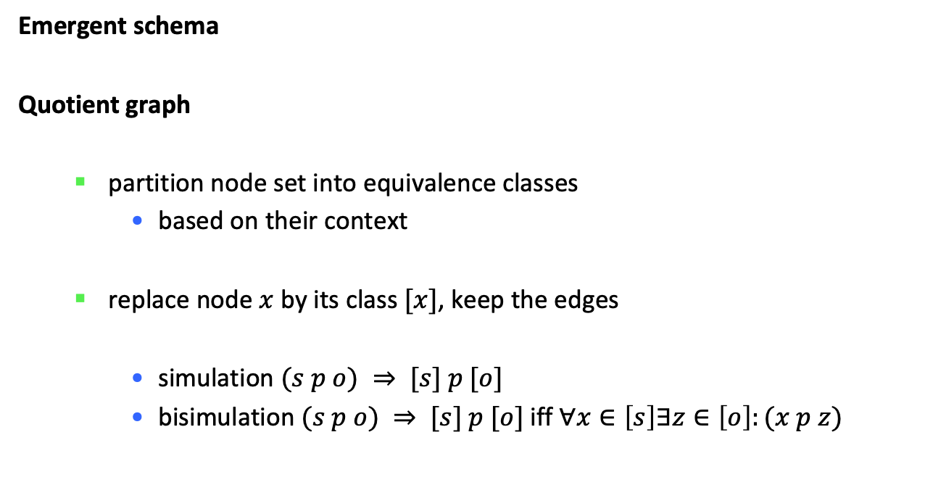
Schema
Emergent schema
Quotient graph
partition node set into equivalence classes
based on their context
replace node $x$ by its class $[x]$, keep the edges
simulation $(s p o) ⇒ [s] p [o]$
bisimulation $(s p o) ⇒ [s] p [o]$ iff $∀x∈\left[s\right]∃z∈\left[o\right]:(x p z)$

Slide 8
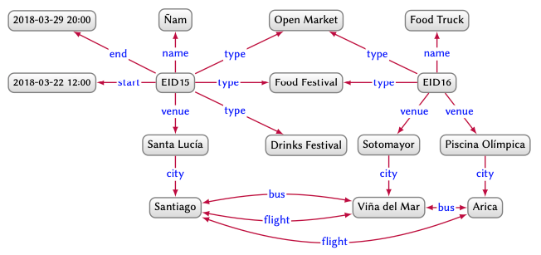
Hogan et al. (2022)

Slide 9
Context
Facts considered true with respect to a context (scope of truth)
temporal
geographic
provenance
Often left implicit, e.g. temporal context = now
Representation
direct (with TIME, PROV, … ontologies)
reification
higher arity
annotation

Slide 10
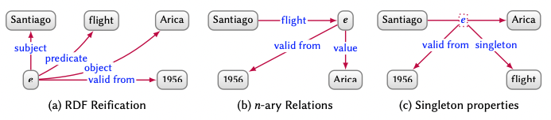
Reification techniques
Hogan et al. (2022)

Slide 11
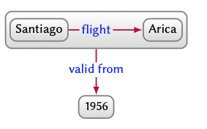
Higher-arity: RDF*
<<:Santiago :flight :Arica>> :valid_from 1956
Remark
<<:Taylor :spouse :Burton>> :from 1968 ; to 1978 .
<<:Taylor :spouse :Burton>> :from 1981 ; to 1983 .
→
<<:Taylor :spouse :Burton>> :from 1968 ; from 1981 ; to 1978 ; to 1983 .
.

Slide 12
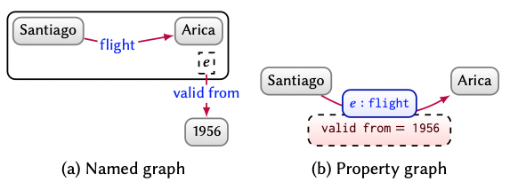
Higher-arity
Hogan et al. (2022)

Slide 13


DEDUCTIVE KNOWLEDGE
Ontologies
Interpretation
Data graph (nodes, edges) → Domain graph (entities, relations)

Slide 14
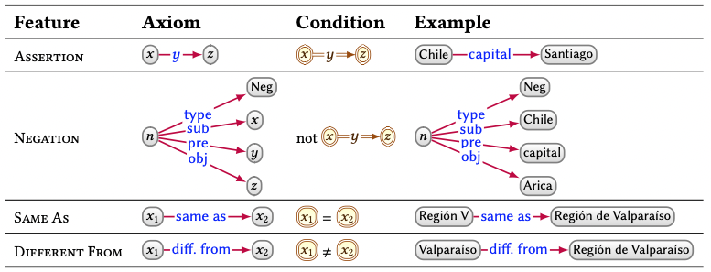
Hogan et al. (2022)

Slide 15
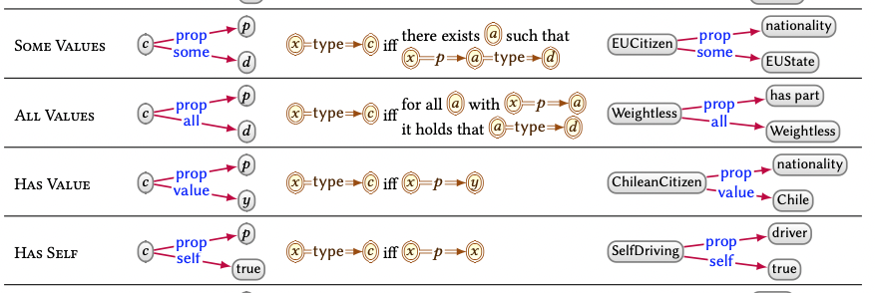
Hogan et al. (2022)

Slide 16
INDUCTIVE KNOWLEDGE
Graph Analytics
Knowledge Graph Embeddings
Graph Neural Networks
Symbolic Learning

Slide 17
Graph Analytics
Discovering interesting patterns
Techniques
Centrality computation
PageRank, …
Community detection
Connectivity
Node similarity

Slide 18
Knowledge Graph Emdeddings
Predicting new edges
Identifying erroneous edges
Machine learning techniques → Numeric input as vectors
How to encode graphs as numeric vectors?
Graph embedding
entity embedding: node → d-dimensional vector
relation embedding: edge → d-dimensional vector

Slide 19
(s p o) → (es rp eo)
define a plausibility function for the edge
goal: find embeddings that
maximize the plausibility of positive edges (in the graph)
minimize the plausibility of negative edges (not in the graph)
Tasks
assign a confidence level to edges
complete edges with missing labels
a basis for similarity measures
duplicate detection
recommendation

Slide 20
Translational model
TransE (edges as transformers)
from (s p o) learn es, rp, eo
goal:
on positive examples: es + rp close to eo
on negative example: es + rp far from eo

Slide 21
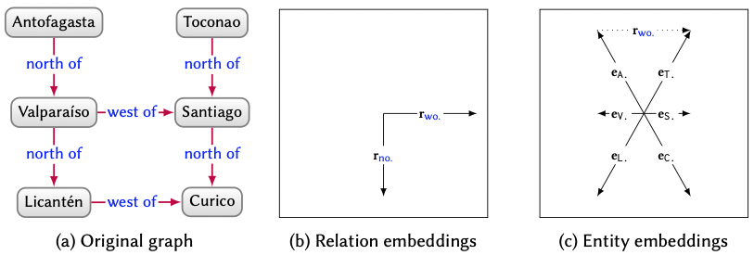
Hogan et al. (2022)

Slide 22
Limitations
transforms everything
(s p o1) (s p o2) → tend to define eo1 = eo2
cyclical relations → 0
Improvements
separate hyperplanes for different relations, …

Slide 23
Language models for embeddings
Leverage proven approaches for language embeddings
word → vector
RDF2Vec
build "sentences" by performing random walks in the graph
input to word2vec

Slide 24
Graph Neural Networks
Classical NN: homogeneous topology (layers)
GNN: topology of the data graph
node → feature vector (fixed)
node → state vector
parametric transition function, input = neighbour nodes information
output function
execution until a fixpoint is reached
the function are implemented using neural networks
learn the parameters to best approximate the results for the supervised nodes

Slide 25
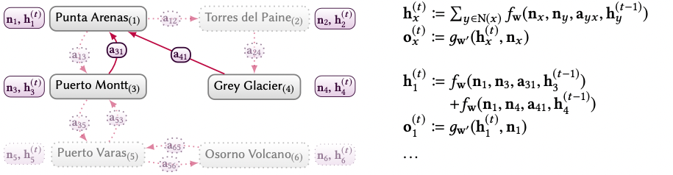
example
Hogan et al. (2022)

Slide 26
Symbolic Learning
Learn rules or axioms
Based on standard data mining techniques
support
confidence

Slide 27
OTHER TOPICS
Creation and enrichment of knowledge graphs from external sources.
Quality dimensions by which a knowledge graph can be assessed.
Techniques for knowledge graph refinement.
Principles and protocols for publishing knowledge graphs.

